Slide 1
Snapdragon 1818113 T.Dharani
DCN Experiment 5

Slide 2
HALF DUPLEX COMMUNICATION USING TCP
AIM:
To write a python program for half duplex communication using TCP.
PROCEDURE- SERVER SIDE:
Step1:Import socket module.
Step2:Create a TCP[Transmission Control Protocol]socket object for communication.
Step3:Bind the socket to the server.
Step4:Wait until connection is established between client and server.
Step5:Receive the data packets from client.
Step6:Send the reply to the client.
Step7.If the reply is disconnect, then the conncection will be closed.

Slide 3
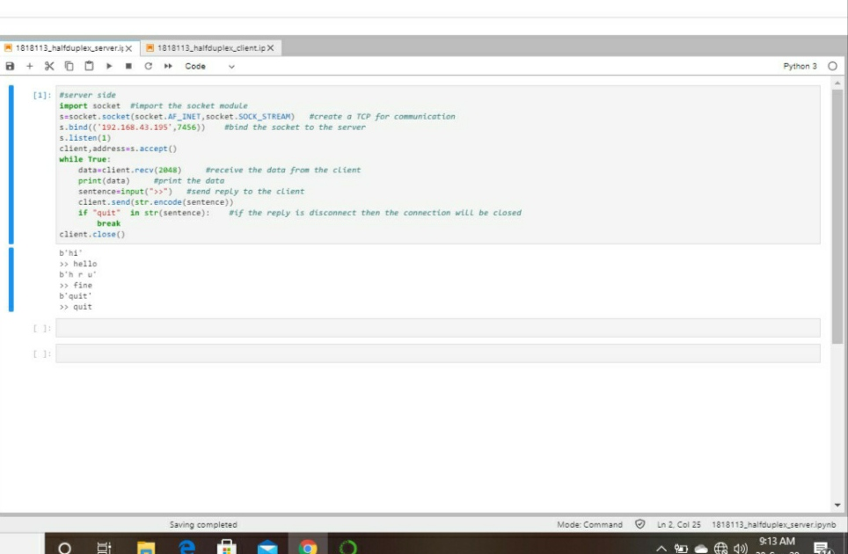
Server side(Output):

Slide 4
Procedure - CLIENT SIDE:
Step1:Import socket module.
Step2:Create a TCP socket object for communication.
Step3:Connect the socket to the server.
Step4:Send a message to the server.
Step5:Receive the message sent by server.
Step6:Print the message.
Step7:If the message is disconnect, then close the socket connection.

Slide 5
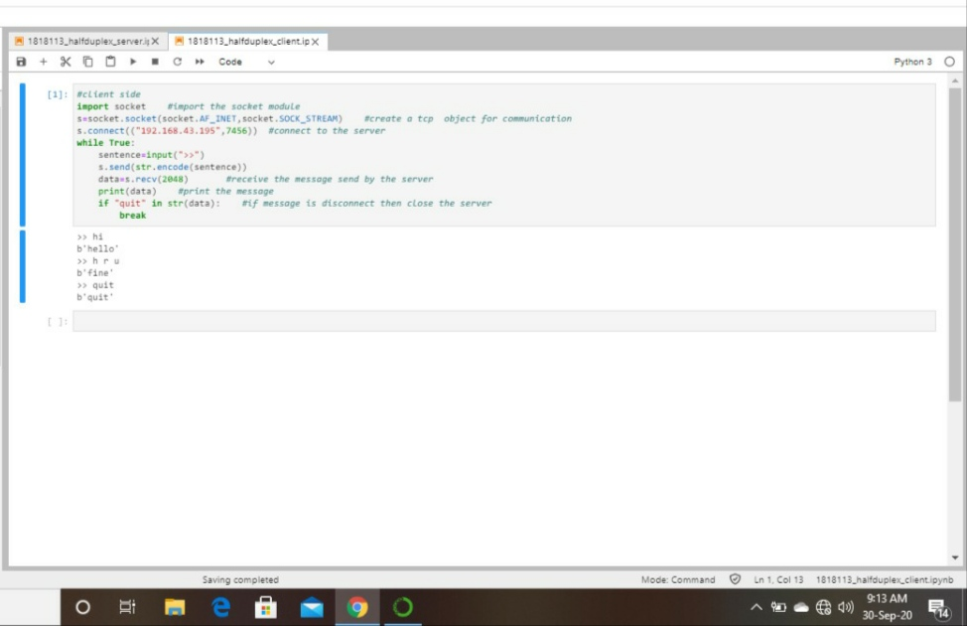
Client side(Output):

Slide 6
RESULT:
Thus the half duplex communication using TCP is implemented.

